Slide 1
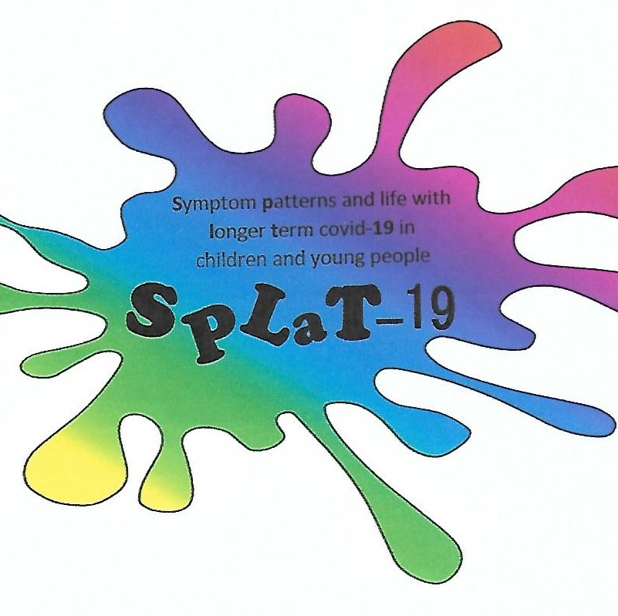
SPLat-19 Symptom patterns and life with longer term covid-19 in children and young people Middleport practice has teamed up with researchers at Keele University School of Medicine to help study the longer term effects of COVID-19 infection in children and young people (aged 8-17 years). You don’t have to have had covid to take part. We will send a text to all children and young people who might be eligible, in the near future. Please check your details are up to date and watch out for it! The study will involve answering online questionnaires every 3 months for 1 year. Some children may be invited to take part in interviews, but this is not essential. Thank you for taking part!. If you have any questions or would like any further information please contact the SPLaT-19 Research Team at Keele Clinical Trials Unit (CYU) on 01782 732950 or ctu.splat19@keele.ac.uk.
SPLaT-19_C GP advert v1.0, 29/4/22, IRAS 310580 RG-0348-22

